Slide 1
AWS Overview
3/30/2021

Slide 2





Multi-account Approach
Orgs: Account management
Logging: Centralized logs
Security: AWS Config Rules, security tools
Shared services: Directory, DNS, limit monitoring
Billing Tooling: Cost monitoring
POC: Experiments needing CFG Connectivity
Innovation Lab: Experiments needing internet (No CFG)
Enterprise Services: Account for Common enterprise tools that do not need connectivity to all Accounts.
(Confluence, Jira, Bitbucket)
P-2: 2 levels below Prod (dev, SIT, iterative QA) Most permissive
P-1: 1 Level below Prod QA, UAT, Staging
Prod: Production
AWS Organizations Master
Digital
Cloud Service Accounts
Commercial Banking
PaaS (openshift)
Shared Services
Security
Logging
Prod
Prod
Prod
Network
Shared
Services
P-1
P-1
P-2
P-1
P-2
P-2
IAM
Enterprise Data Banking
Enterprise Services Accounts
Consumer Banking
Prod
Prod
Prod
Prod
P-1
P-1
P-1
P-1
P-2
P-2
P-2
P-2
External Vendor
POC Accounts
Data Center
Prod
P-1
Developer
POC
Innovation Lab
P-2

Slide 3
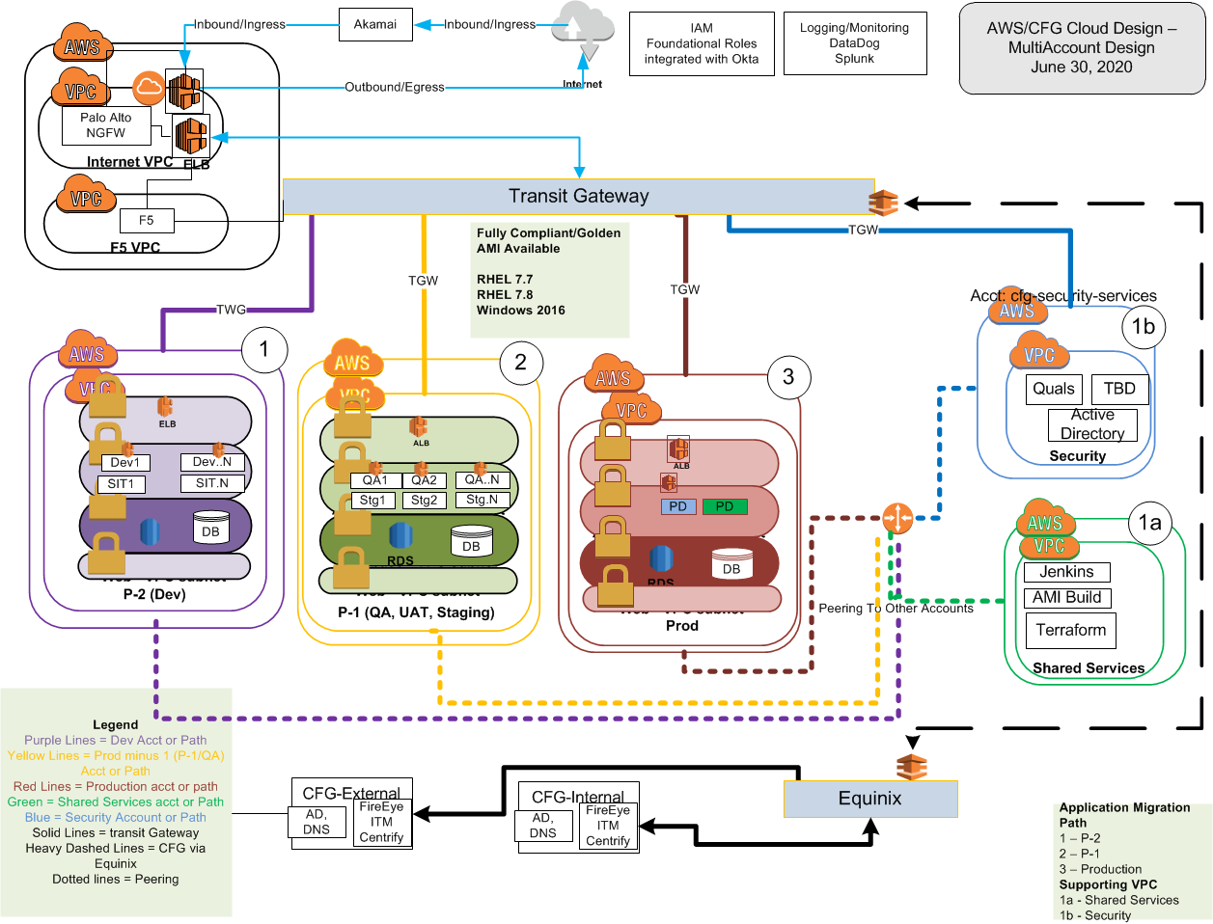
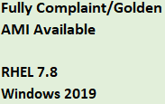
Application Eco-System Design
Notes:
AWS Infrastructure
AWS Accounts
Set up of new Accounts if required for Division (P-2 (Dev/SIT), P-1 (QA, Performance), Production,
Connectivity to enterprise accounts (Security Services, Shared Services, Logging)
Creation of Non Application Roles (user and infrastructure roles) to access AWS Services
Infrastructure Roles - Networking Admin, Cloud Admin, Server Admin, Key Management Admin
Integration of Infrastructure Roles with Okta/Sailpoint
Integration of Accounts/VPCs with Splunk for infrastructure (cloud trail, vpc flow logs) logging
Networking
VPC – Virtual Private Cloud for Accounts Created
Subnets
Created per approved design (Web, App, Data, Management)
Security groups
Firewall configuration at AWS
Infrastructure –
Connectivity from CFG to AWS for SSH (22) and RDP (3389) , HTTPS (443) access from DaaS and Cloud Jump Server
Connectivity to CFG for all key Agents (ITM, HPUD, Centrify, FireEye, Qualys, SSM, Netcool, AD, DNS)
Connectivity to CFG
Direct Connect (Equinix)
Transit Gateway
Connectivity to Other AWS Accounts/VPCs per design
Internet Connectivity
Inbound (Ingress) Palo Alto Firewall Set up Only – will not be opened to the internet until an application is installed and approved
Outbound (Egress) Palo Alto will be set up with access to approved URLs only.
Outbound (non Palo) for any URLs not approved for access with out DLP. This will leverage the CFG Proxy Servers.
Infrastructure
Terraform Scripts and Golden AMI for Windows 2016 and Linux (RedHat 7.7 and 7.8) to use in creation of new in instances/servers
Scripts and Build pipelines for
Backup Process
KMS Encryption Keys for services.

Slide 4
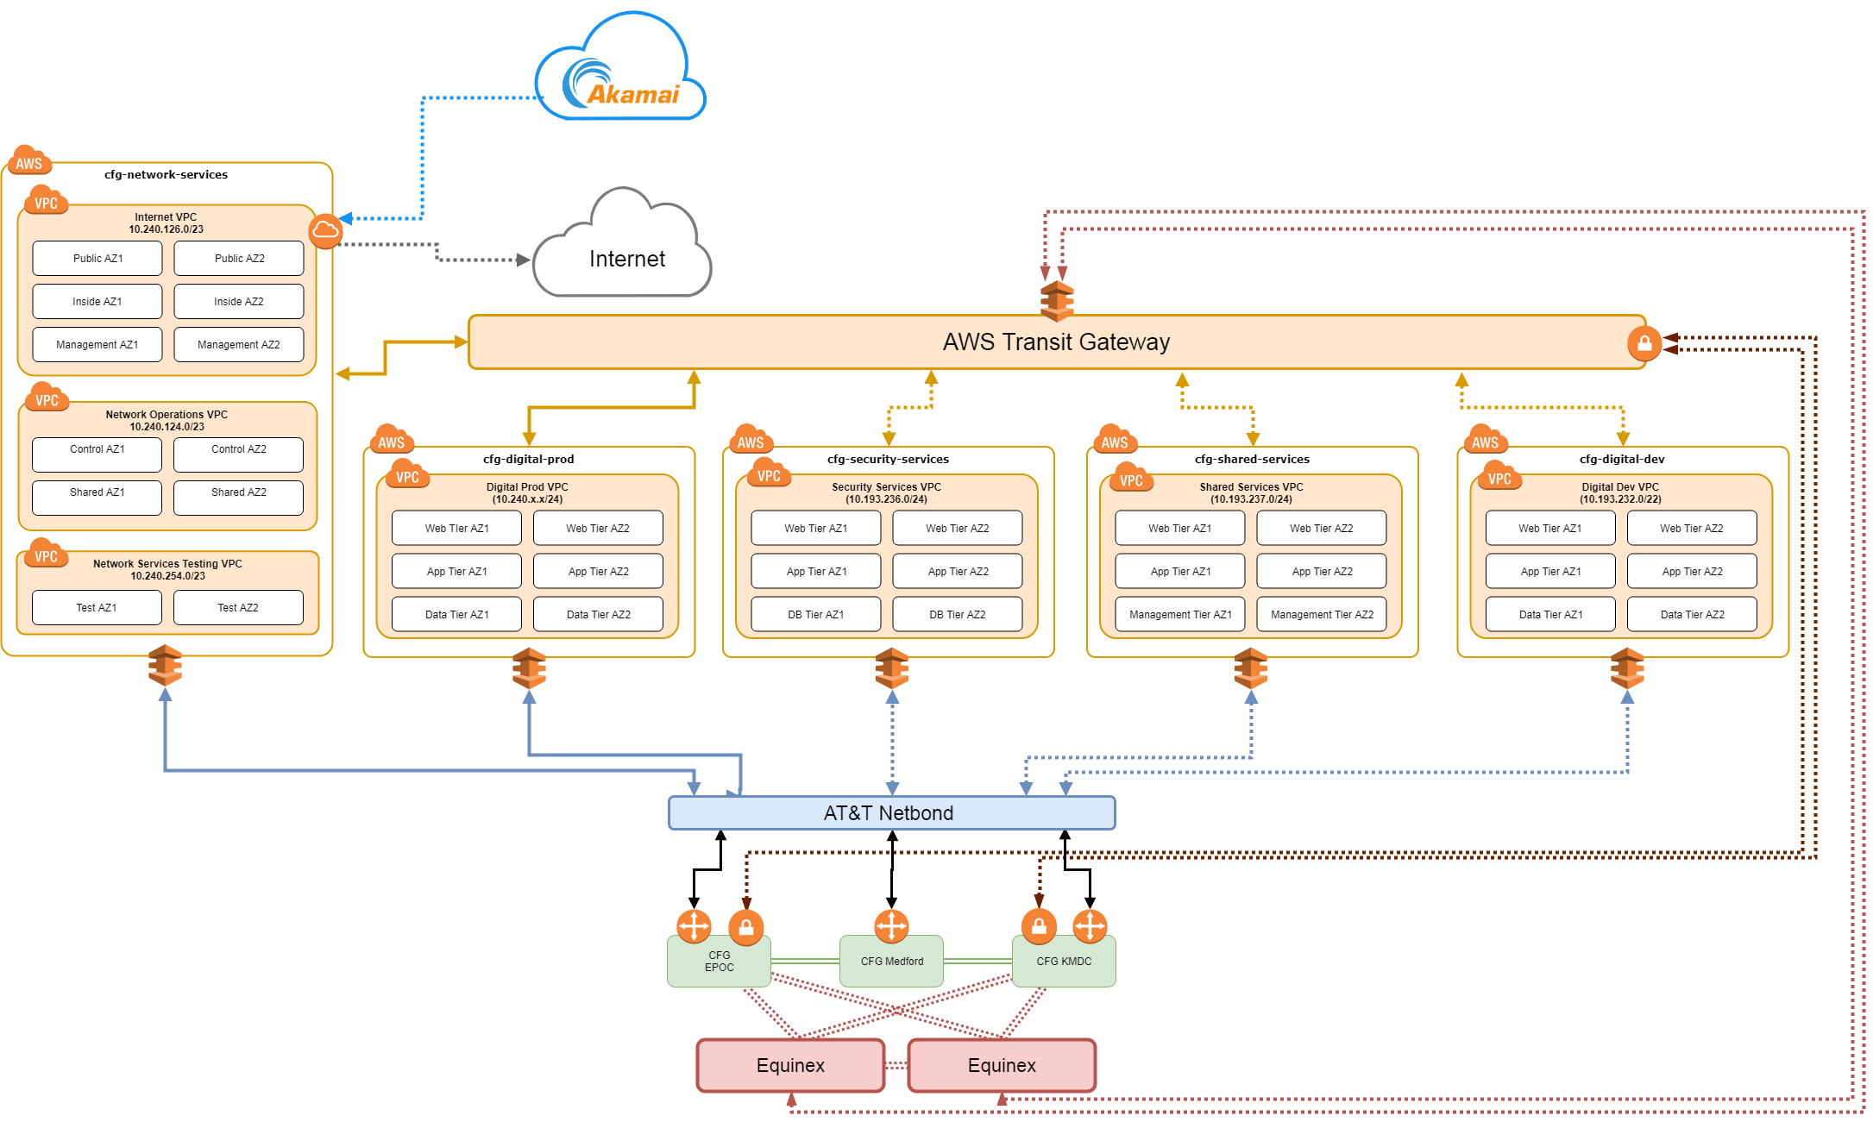
Transit Gateway End State Design
AWS Transit Gateway connects VPCs and on-premises networks through a central hub. This simplifies the network and acts as a cloud router

Slide 5
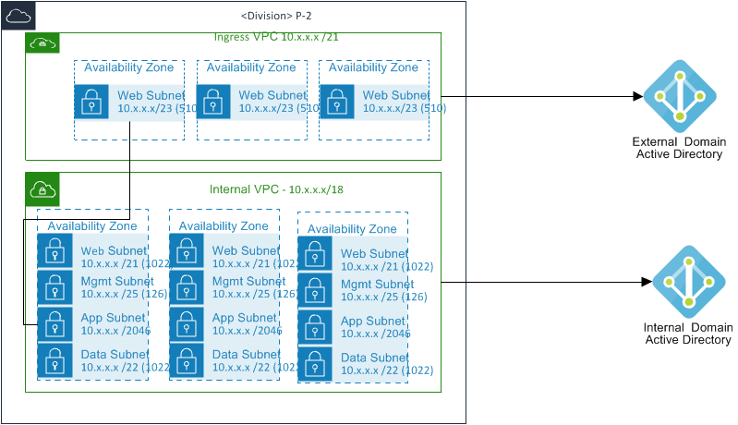
Standard Account with VPC Design
Notes:
Inbound Internet to the Ingress VPC only – External AD Access
Internal VPC (No Internet Access) - Internal AD access
Web = DMZ – Connectivity from External/Untrusted
App = No Data - Connectivity from Trusted Servers (i.e. Data Center/AWS)
Data = Data Stores - No Connectivity to CFG or Internet
Mgmt – Bastion Hosts, Tools Servers, Operational Tools
Subnet size can change but quantity (4) and type (App, Web) remain standard.

Slide 6
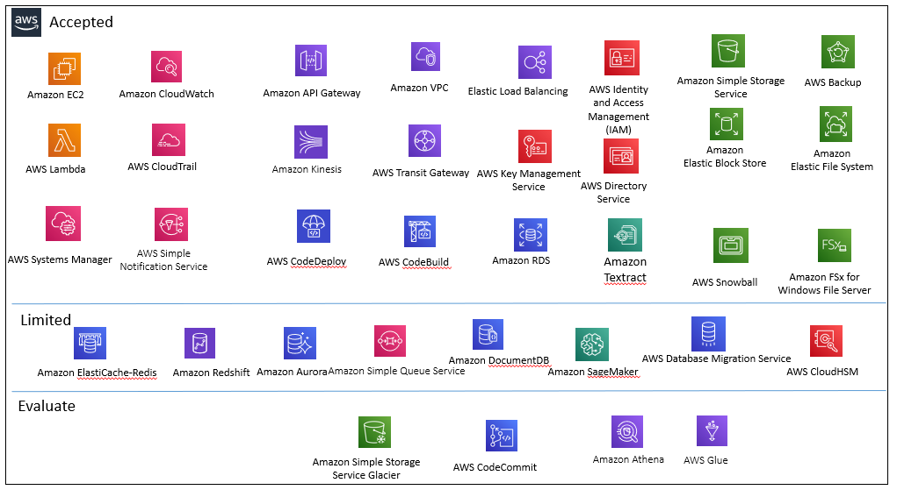

Slide 7
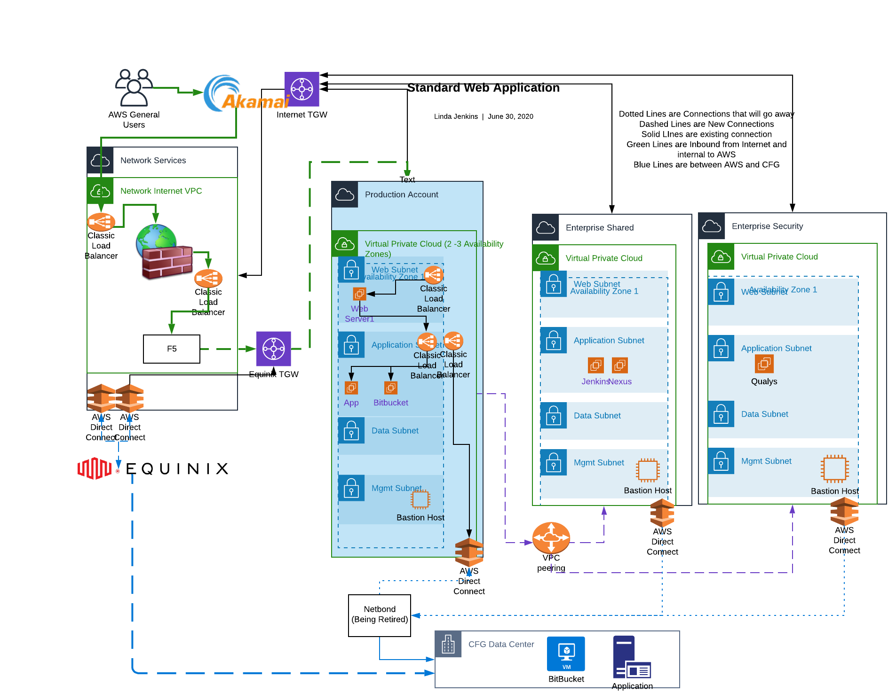

Slide 8
AWS Tagging Standards https://confluence/display/CT/Cloud+Tagging+Information
AWS tags can be associated with any AWS service. Tags are used to provide meta-data regarding the AWS object, instance, etc. Up to 50 tags can be used for any given item. CFG will enforce the use of a subset of tags in order to support cost transparency and operational support. Below are the tags (mandatory and non-mandatory) that will be used. Application owners can leverage the remaining tags for their own use.
Technical Tags
Name - See Naming Conventions - Cloud Naming Conventions
ApplicationID – GRC SYSID Application ID
Environment – This is the application environment - Dev, SIT, QA, Production, Training
Criticality – Tier 1,2,3
BackupPlan - see values below in "AWS Resource Backup Plan Policy"
Patch Group - see values below in "Patch Group Tag Instructions"
Version (Optional)
assignmentgroup - The assignment group within Service Now for the application. Used when opening tickets within Service Now.
BusinessMapping - This value is required by Service Now for Application Assets.
ServerType = used for OS access
Status – Used for Termination
Business Tags
Requestor - Email address of requestor
Support – Part of Email of Distribution list prior to @ sign (i.e. DL-OlbApplicationSupport)
CostCenter – BAU RC (expense) - as this is a long term recurring cost
Automation Tags
Schedule - Will automatically stop and start instances at a pre-defined schedule
Values ctp-office-hours (start time = 7:30AM stop time = 5:30PM)
Security Tags
DataClass – Identify data confidentiality ACTION - Need to get the Values of Confidentiality
Class4 (yes/No) - May or may not be needed depending on the definition of the confidential classifications.
Compliance – to identify if it needs to adhere to compliance standards (GLBA, Payments, REgE ETC) - ACTION - Need to get list of compliance values (numeric-preferred or Words)

Slide 9
Application Ownership What will be implemented as part of an application Launch
Execution of Scripts to build infrastructure
Network diagram and AD groups to be used for application or user access to the servers.
Networking
Application Security groups added after initial launch of AWS.
I.e. for Digital (Kubernetes, Application Specific Web, App, DB security groups)
Connectivity to CFG
Connectivity to Application Database
Connectivity from Application Specific Servers
Connectivity to Other AWS Accounts/VPCs requested after the initial launch of AWS.
Internet Connectivity
Akamai Integration/Set up, as this is application specific
Addition of application specific URLs needed.
List of all S3 buckets required
Deployment of Application Specific Infrastructure (VM’s, Load Balancers, Databases) to support the application
This will leverage the AMI’s provided by the Cloud Team, but will not be created until the application team creates them.
Deployment of the Application

Slide 10
Additional Information for Deeper Info

Slide 11
How to Connect to AWS
AWS Access
Console - leverages internal AD integration with Okta for authentication.
Each application is provided a role for read only access. All infrastructure connectivity should leverage the build pipeline.
New AD groups much be created on prem as new applications need access.
Command Line
May leverage Okta Client for access
Service roles
OS/Instance level access
Leverages CFG AD access
Internet facing VPC’s use the cfg external domain
Non-Internet facing VPCs use the cfg internal/corp domain
Access approved on “ServerType” rather than server Name
AD group and PAMs forms must be created and approved one time only.
Tagging used to Identify server type and integrate with appropriate AD groups.

Slide 12
Monitoring and Logging
Splunk
All infrastructure information that is collected via CloudTrail
DataDog
Standard connectivity and rules that are in place today for on-prem (PUM, Audit, OS)
Netcool
Standard connectivity and rules that are in place today for on-prem
POC - Gardium/Jsonar – Database Monitoring
Cloudwatch –
CASB -
Web Inspect
App Dynamics – Application Monitoring for apps that meet the criteria.

Slide 13
Data Movement
GIS to send files to and from AWS is approved for use. Set up is the same as in use today.
Department Shares for non-internet facing VPCs
S3 Buckets use to access data in AWS.

Slide 14
Traffic Flow - Security Group Information
Source |  |  |  | Destination
VPC / Data Center | Subnet | Group (Logical or SG) | → | VPC/Data center | Subnet | Group (Logical or SG) | Protocol | Port(s) | Comment | Team
CFG | Example - LAN Users, VPN Users | n/a | → | Shared | App Tier | shsvc-app-nexus-registry-servers | tcp | 443 | CFG access to management UI | Digital
Dev | Example Web Tier, App Tier | dev-web-sg, dev-app-sg | → | Shared | App Tier | shsvc-app-nexus-registry-servers | tcp | 8504 | EC2 instances pull docker and other images from the registry | Digital
Dev | Example Broker Server | dev-bkr-sg | → | CFG | n/a | APi Connect (apiconnect.citizensbank.internal.com | tcp | 443 | To access approved APIs in the bank | CTP

